Slide 1
Analysis of Egyptian Tech Salaries 2024

Slide 2
Introduction
726
The Egyptian tech industry has been rapidly growing, attracting significant attention from both local and international companies. As the demand for tech professionals increases, understanding the salary landscape becomes crucial for job seekers and employers. This project aims to analyze the salaries of tech professionals in Egypt using about 730 volunteer after data cleaning , providing insights into the factors that influence earnings in this sector.

Slide 3
Count job title

Slide 4
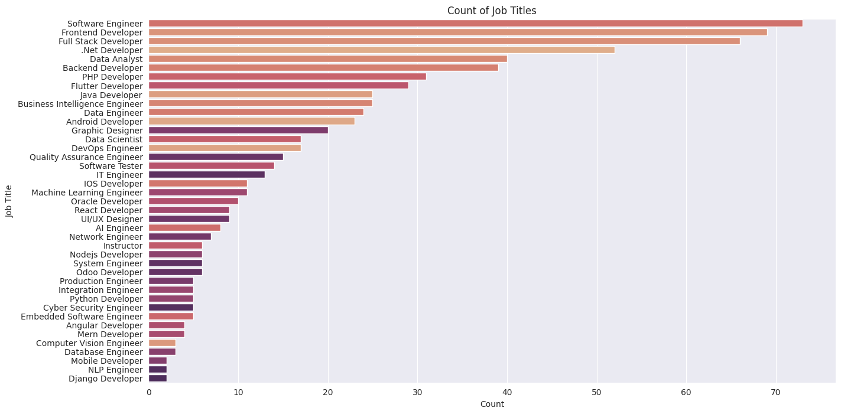
Job titles

Slide 5
Salary Distribution For Each Job Title

Slide 6
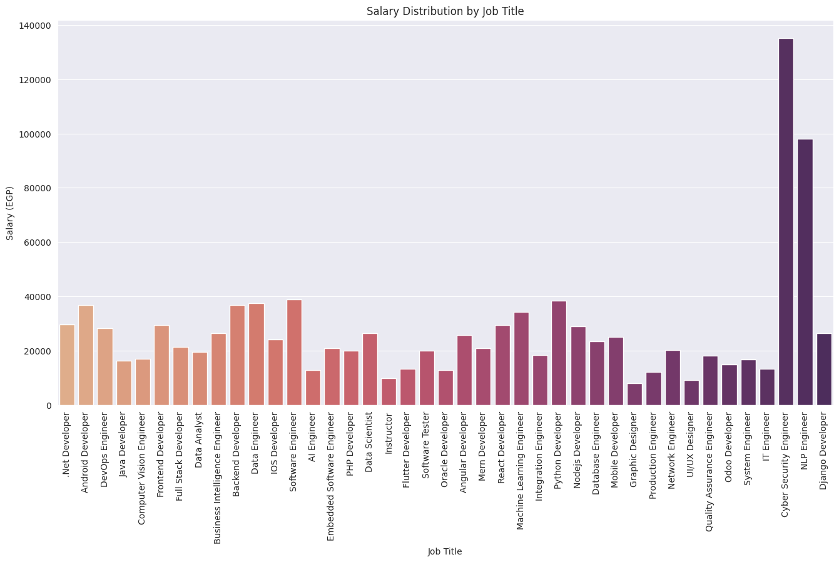
Job titles

Slide 7
Compare Each Job Title By Salary

Slide 8
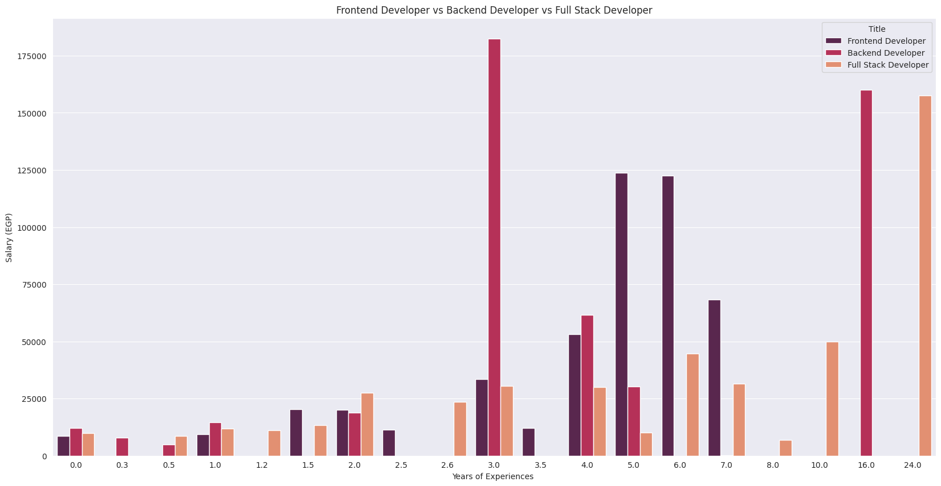
Web development

Slide 9
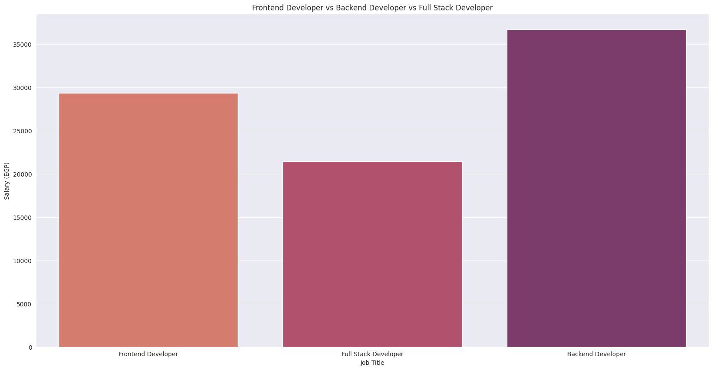
Web development

Slide 10
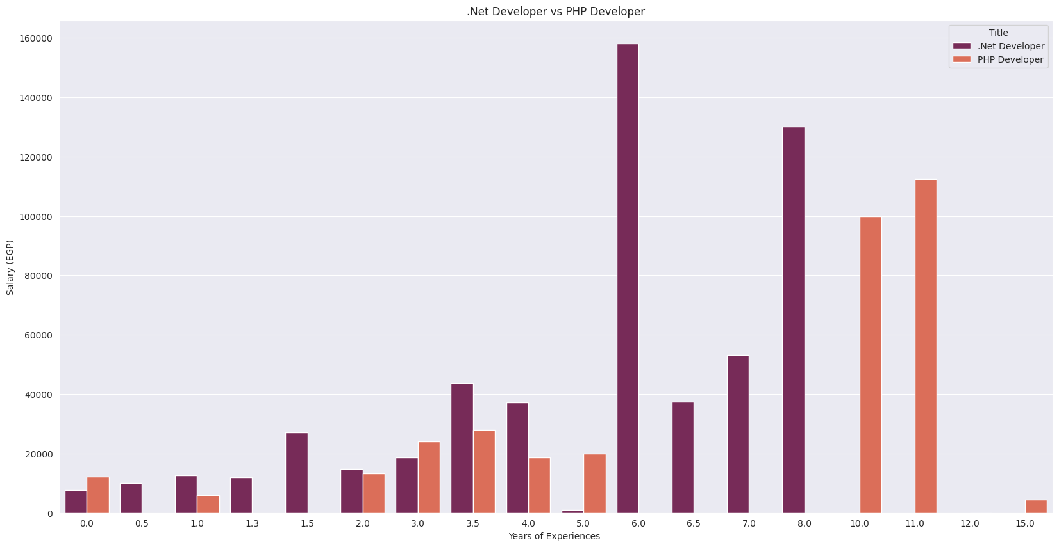
Web development

Slide 11
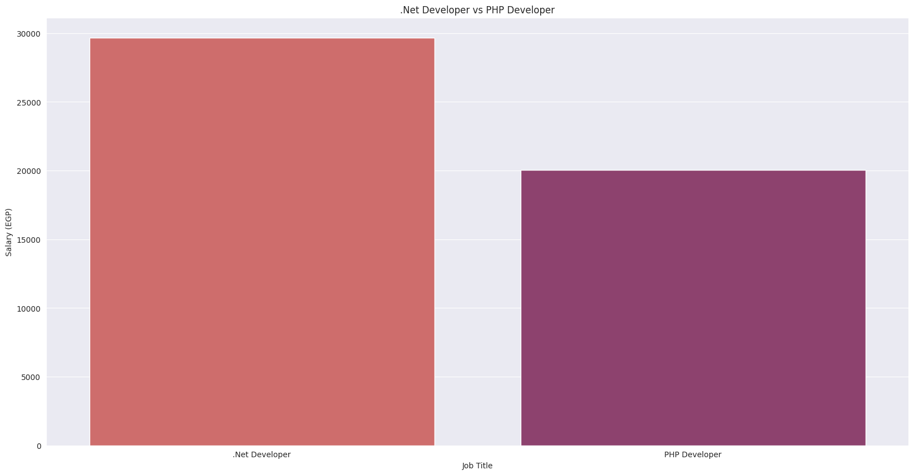
Web development

Slide 12
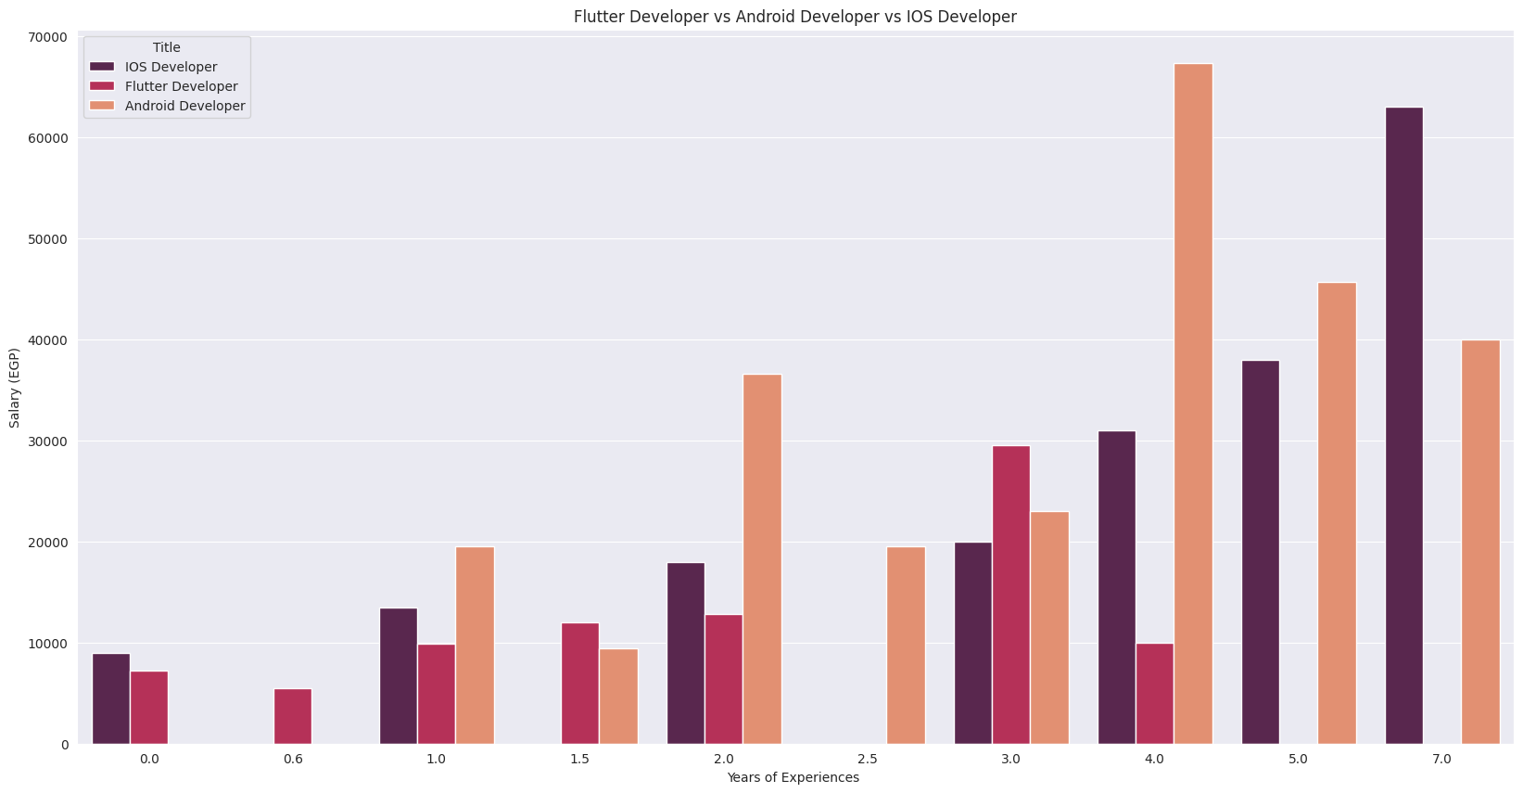
Mobile development

Slide 13
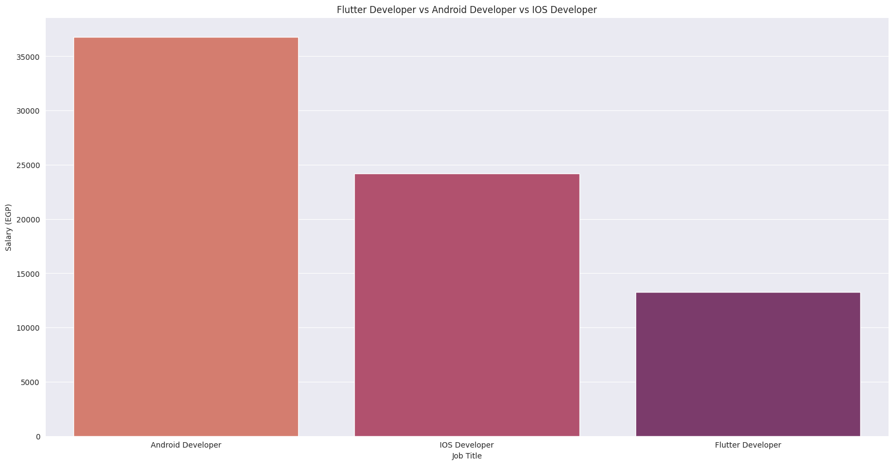
Mobile development

Slide 14
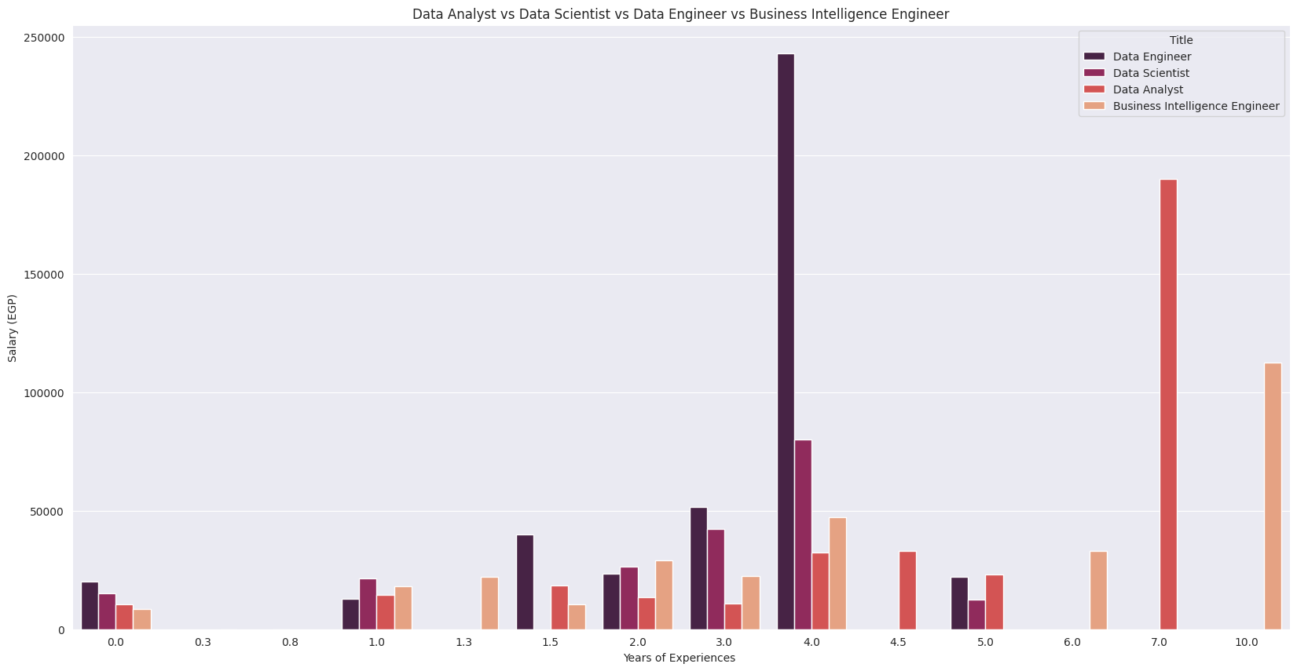
Data jobs

Slide 15
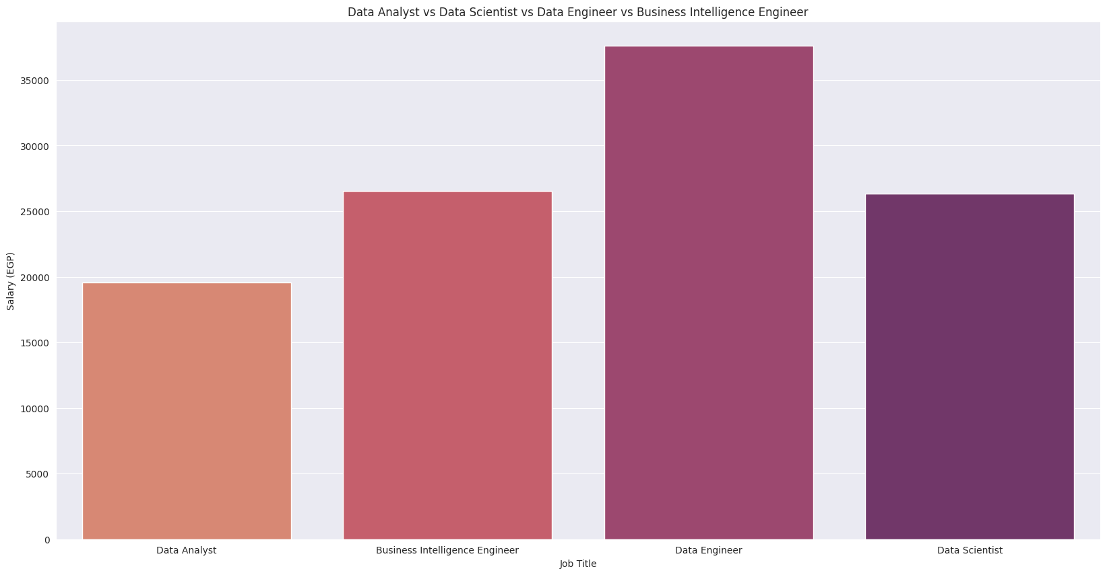
Data jobs

Slide 16
Work Type Distribution

Slide 17
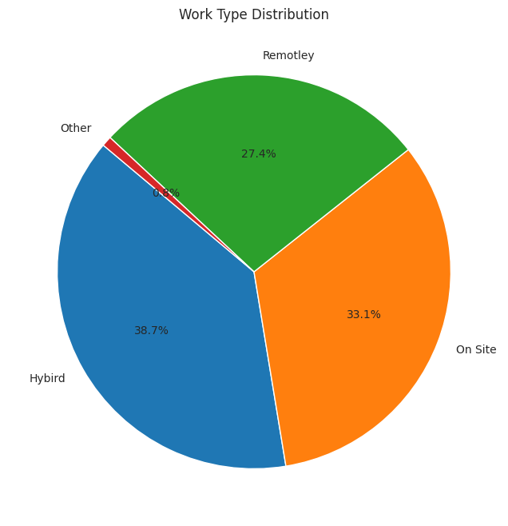
Work Type Distribution

Slide 18
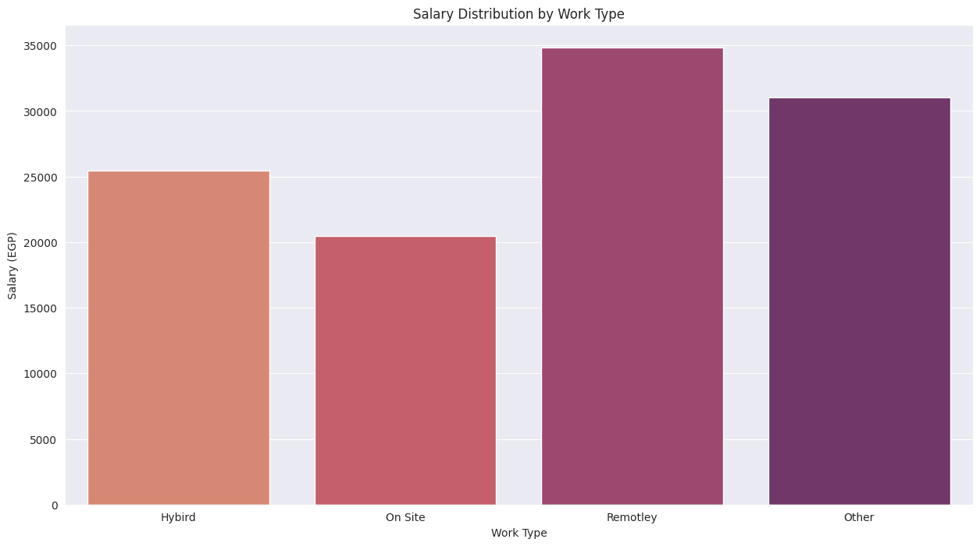
Salary Distribution by Work Type

Slide 19
City of Company site

Slide 20
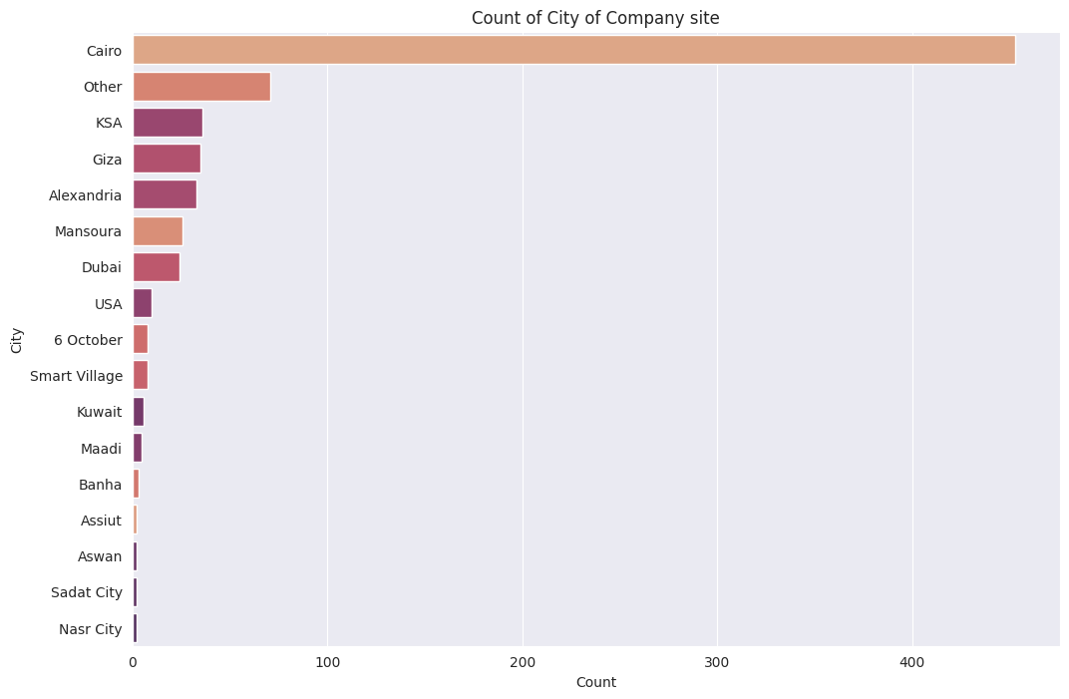
City of Company site

Slide 21
Working Hours

Slide 22
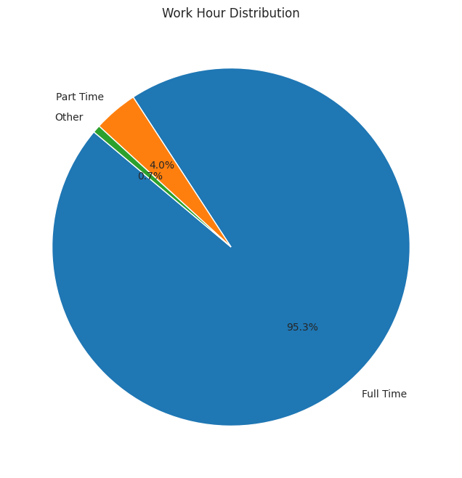
Working Hours

Slide 23




Thanks for Mohamed Elmnegged for collecting data
Project Link
Contact me :
GitHub
LinkedIn
Gmail

